Slide 1

Welcome
EIC EDGE – Week 3 CI/CD and the Cloud

Slide 2
Why study these subjects?
In modern software engineering, our ability to quickly deploy incremental innovation, ensure its quality, and scale to meet customer demand proves critical to our success
Cloud is everywhere and it’s not going away
As with many topics in technology, there are multiple options and multiple dimensions to those options
Building a deeper understanding of Cloud and its offerings helps prepare you for modern IT
Included in that is the importance of learning about the build and operation of CI/CD pipelines using Cloud native technologies

Slide 3
My pledge to you
I will...
Make this interactive
Ask you questions
Ensure everyone can speak
Use an on-screen timer

Slide 4
Objectives
At the end of this course, you will be able to:
Speak to available Cloud native capabilities utilized to build out complex infrastructure environments for hosting and execution of our workloads
Demonstrate the ability to create simple Cloud resources in a modern Cloud Service Provider (CSP)
Use Cloud native technologies to build and operate simple CI/CD pipelines

Slide 5
Agenda
Day One
Hosting Applications in the Cloud
Day Two
Cloud Native Options in AWS, Part 1
Day Three
Cloud Native Options in AWS, Part 2

Slide 6
Agenda
Day Four
AWS CodeBuild
Day Five
AWS CodePipeline

Slide 7
How we’re going to work together
Lab work will take place in individual workspaces – isolated, browser-based virtual machines
Classroom labs may include individual work as well as group discussion and work
I welcome being interrupted – if you need more info, or clarification, or anything else, just break in and ask. I am here to help you.

Slide 8
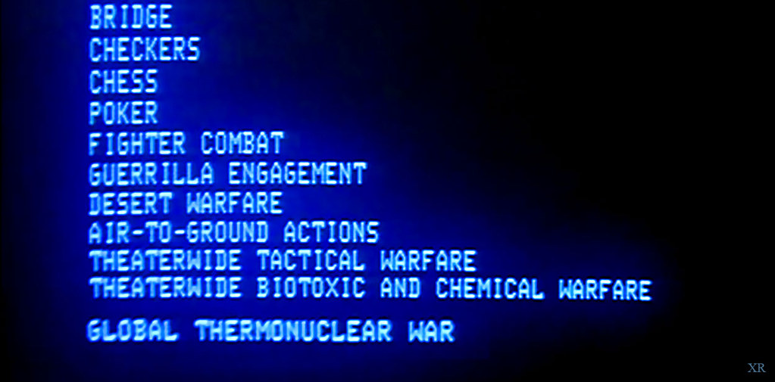
Would you like to play a game?
To make it interesting, let’s add a competition factor to our time together ☺
For questions posed to the larger group, 1 point will be awarded for each answer provided by a participant
2 points will be awarded for acting as a spokesperson for a breakout room during one of our group discussions
There will be a rubric provided for the capstone (targeted for week 4) which will define a points breakdown for the implemented solution

Slide 9

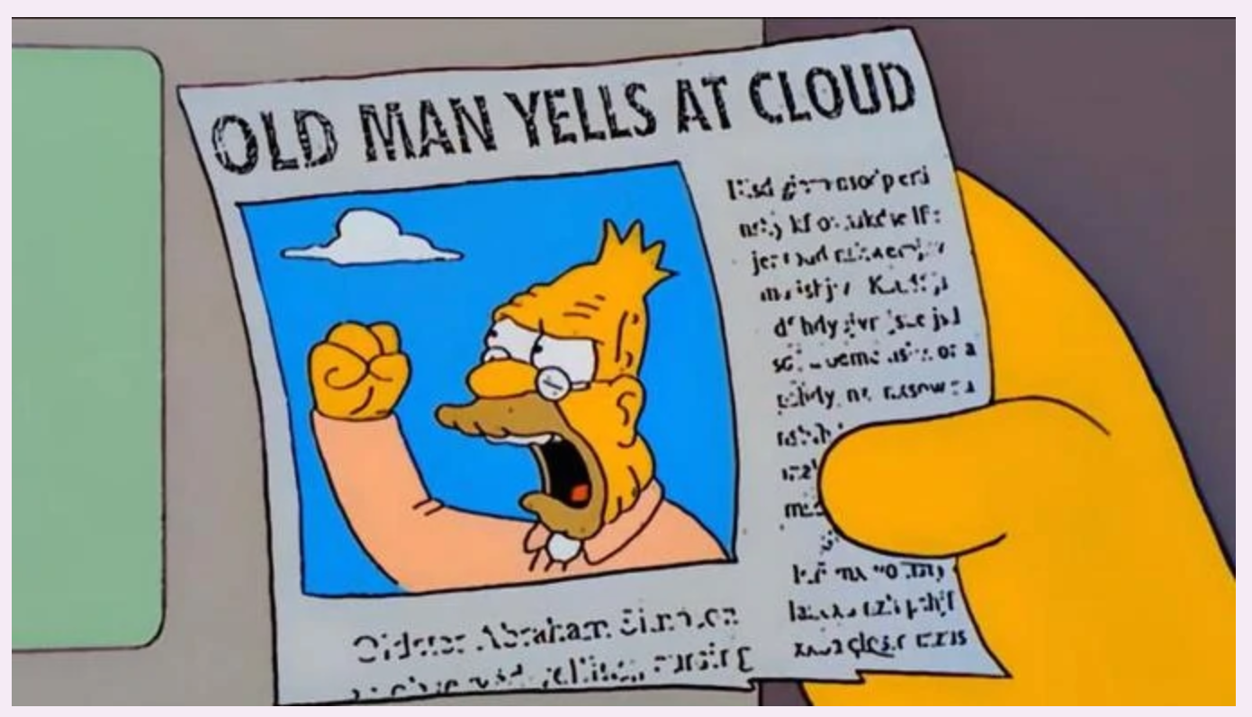
Open Discussion
What is “the Cloud”?
How does “the Cloud” factor into modern IT?

Slide 10
Hosting Applications in the Cloud

Slide 11
Infrastructure Options

Slide 12

Infrastructure Options
Infrastructure is the hardware & software that run our IT workloads and that provide our business users and customers a way to interface with the applications required to complete their daily jobs

Slide 13




What Are the Options?
On-Premise (in a Data Center)
Public Cloud
At the Edge
Hybrid Cloud
What do they all mean?

Slide 14

On-Premise
Can mean a few different things:
In a wholly-owned Data Center
In a COLO (or co-location Data Center)
Sometimes called a “private cloud”

Slide 15
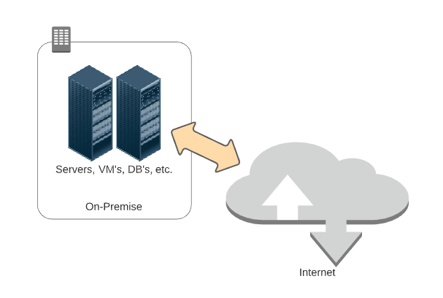
On-Premise
Notes:
Client systems/other locations interacting with the apps in the data center over a corporate network

Slide 16

On-Premise
Why and What?
How infrastructure has traditionally been done
With this model, companies try and estimate current & future hardware capacity needed to support business operations

Slide 17
On-Premise
Why and What?
Stakeholders plan out expected levels of consumption for the next 3 – 5 years (capacity to handle current volumes as well as expected growth)
Some critical workloads may not be suitable for anything but a physical and directly-managed implementation (e.g., mainframe)

Slide 18

On-Premise – Discussion
Pros? | Cons?
Discrete capacity planning (even if that planning was off) | Sometimes difficult to know what is needed and when it is needed – if the plan was off (or unexpected spikes in demand occurred), difficult to adjust quickly
Some workloads (e.g., mainframes and certain legacy systems) are tailor-made for a physical data center | Some workloads are just as effective (if not more so) in a virtual vs. physical implementation
With a move to COLO’s, companies could begin to share expenditure | Harder to control costs and plan for costs – CAPEX vs. OPEX
Notes:
Use as an opportunity for group discussion – get students’ thoughts on potential pros & cons. Guide the discussion to promote feedback.

Slide 19
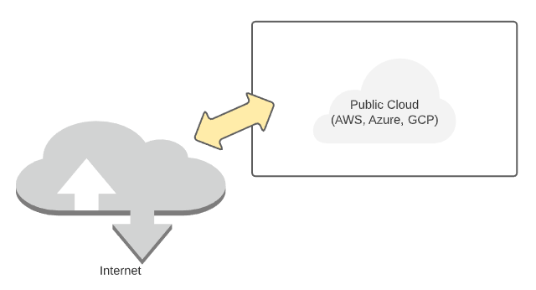
Public Cloud

Slide 20

Public Cloud
Why and What?
Platform using the standard “Cloud computing model” to provide infrastructure and application services
Accessed and integrated via the Internet
May provide a few different types of services – IaaS, PaaS, etc.
Notes:
Mention that we’ll discuss IaaS, PaaS, etc. in some upcoming slides

Slide 21
Public Cloud
Why and What?
Usually supports a subscription or “pay as you go” (on-demand) pricing model
Largest players in this space include Azure, AWS and GCP
Notes:
Mention that we’ll discuss IaaS, PaaS, etc. in some upcoming slides

Slide 22
Public Cloud - Discussion
Pros? | Cons?
Flexibility and elasticity in capacity planning – enables automated schedule-based or metrics-based adjustments to capacity when required | Requires enough historical data for schedule-based planning or the right configuration for metrics-based planning
In some cases, managed services can be leveraged reducing operations overhead | With managed services you lose some levels of granular control
Because services are PAYG (pay as you go), you’re only charged for what you use, and those expenses are OPEX | Because of the flexibility/elasticity, it can be difficult to budget and, if Cloud services are not managed/monitored, costs can be high
Notes:
Use as an opportunity for group discussion – get students’ thoughts on potential pros & cons. Guide the discussion to promote feedback.

Slide 23
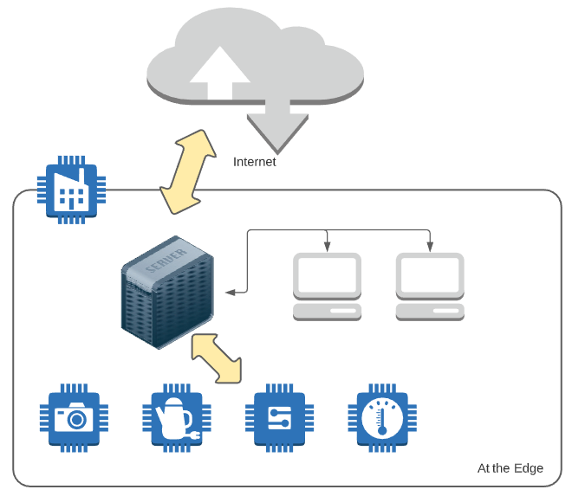
At the Edge

Slide 24




At the Edge
Can include 3 distinct layers:
Inner or Near Edge
Middle Edge
Outer or Far Edge

Slide 25
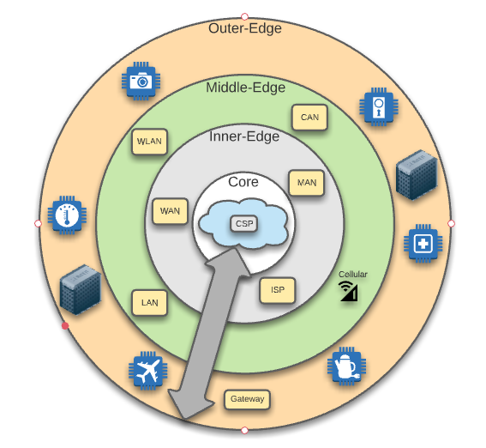
At the Edge – Layers
CSP – Cloud Service Provider
WAN – Wide Area Network
ISP – Internet Service Provider
MAN – Metropolitan Area Network
LAN – Local Area Network
WLAN – Wireless Local Area Network
CAN – Campus Area Network

Slide 26

At the Edge
Why and What?
It’s about bringing the power of Cloud computing to you
Enables additional processing closer to the sources of data while still supporting the offload of higher order processing to the Cloud
Often involves setting up “Cloud-in-a-box” facilities on-premise

Slide 27
At the Edge
Why and What?
IoT (Internet of Things) is a good example – devices in a facility reading massive amounts of data can incorporate processing at the edge to improve overall efficiency
Helps inject lower latency, increased security and improved bandwidth into systems used to aggregate critical data for an enterprise

Slide 28
At the Edge - Discussion
Pros? | Cons?
Allows distribution of processing power across a larger surface area | Requires more infrastructure and more configuration to support that distribution
Can be used to bring critical latency, security and bandwidth improvements to specific types of business workflows | Increased distribution of processing power and activity can expand attack surface and requires the right configuration to ensure optimal interaction between system components (i.e., increased complexity)
Efficiencies gained “at the edge” can help with managing the cost of processing data | More components “at the edge” can lead to increased infrastructure costs
Notes:
Use as an opportunity for group discussion – get students’ thoughts on potential pros & cons. Guide the discussion to promote feedback.

Slide 29

Hybrid Cloud
Why and What?
In many ways, an amalgamation of the other options
Supports distribution of system processing across on-premise infrastructure and the public Cloud
Notes:
Edge is a specialized type of hybrid cloud (often for IoT)

Slide 30
Hybrid Cloud
Why and What?
Allows an enterprise to keep workloads that are best-suited for on-premise running on-premise while allowing migration of components that can move to the public Cloud
Can help make an enterprise’s move to the Cloud more gradual and planful
Notes:
Edge is a specialized type of hybrid cloud (often for IoT)

Slide 31
Hybrid Cloud - Discussion
Pros? | Cons?
Allows distribution of processing power across a larger surface area | Requires more infrastructure and more configuration to support that distribution
Can allow a move to the Cloud to be more gradual and allow an enterprise to target optimal deployment platform while making the move | As with Edge, can lead to increased complexity, often including required setup and maintenance of dedicated, secure connectivity between a data center and the Cloud
The ability to support a gradual move enables an enterprise to assess and understand Cloud costs over time | If not managed optimally, costs can be higher due to need to pay for Cloud usage and data center (CAPEX + OPEX)
Notes:
Use as an opportunity for group discussion – get students’ thoughts on potential pros & cons. Guide the discussion to promote feedback.

Slide 32
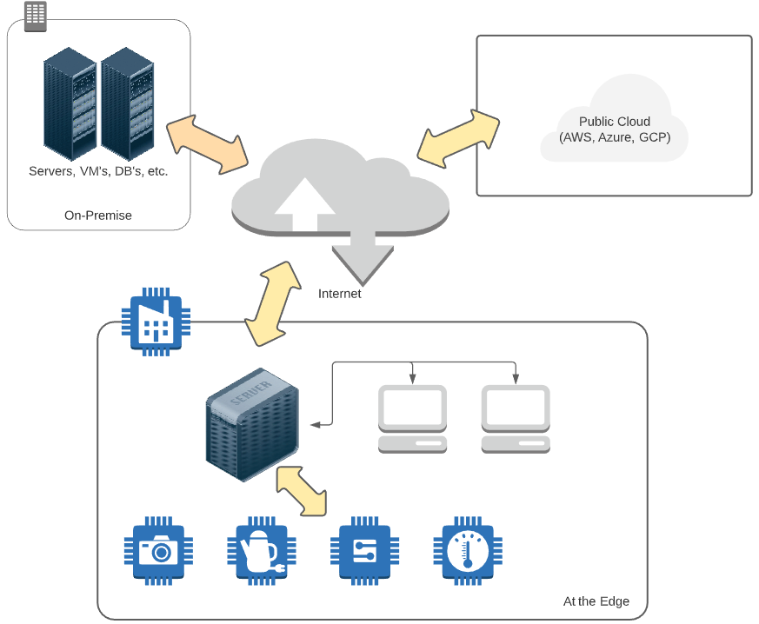
Hybrid Cloud
Notes:
Some combination of any (or all) of the three

Slide 33
LAB:
Scenario: Your company (a global leader in FinTech) is currently hosting all infrastructure used to power the business in an on-premise Data Center. This includes a mainframe for primary business functions (customer management, account management, accounts payable, accounts receivable), several Web Apps (for customer interaction), several Web APIs providing backend data and functionality to the UIs, and a system used to manage data feeds from several security cameras used at corporate offices for observation and security.
As a member of the technical staff, you have been asked to provide thoughts and recommendations on moving from the Data Center to the Cloud.
In your assigned breakout room, discuss as a group and be prepared to provide the following: 1) Potential options for infrastructure in the Cloud for the different types of workload, and 2) considerations that the company should keep in mind as they make the move to ensure awareness and proactive planning.
Nominate someone (or volunteer) to share your group’s ideas.
Infrastructure Options

Slide 34

Knowledge Check
With this infrastructure option, stakeholders try to estimate hardware & software needs for the next 3 – 5 years:
Public Cloud
At the Edge
Hybrid
On-Premise
Notes:
Type answers in chat or come off mute.
Answer is D

Slide 35
Knowledge Check
This infrastructure option focuses on bringing additional power closer to the data sources and application users:
Public Cloud
At the Edge
Hybrid
On-Premise
Notes:
Type answers in chat or come off mute.
Answer is B

Slide 36
Knowledge Check
This infrastructure option seeks to build a solution by combining the other options into a larger solution:
Public Cloud
At the Edge
Hybrid
On-Premise
Notes:
Type answers in chat or come off mute.
Answer is C

Slide 37
Application Hosting

Slide 38
Application Hosting
By Application Hosting, we mean the target infrastructure and runtime platform used for deployment and execution of an application or system; can include compute (CPU and server resources), storage, network, data and operating system

Slide 39
Application Hosting – An “Interesting” Example?
Here’s an example of someone thinking “outside-of-the-box” when it comes to application hosting!
https://mashable.com/article/pregnancy-test-doom/

Slide 40

What Are the Hosting Options with Cloud?
IaaS
PaaS
Serverless / FaaS
SaaS
Containers
What do they all mean?
Notes:
We touched on this briefly in week 02 – this week, we’re going to dig in further

Slide 41

Infrastructure-as-a-Service (IaaS)
Involves the building out (and management) of virtual instances of:
Compute
Network
Storage
Akin to spinning up a server (physical or virtual) in your location or data center complete with disks and required network connectivity

Slide 42
Infrastructure-as-a-Service (IaaS)
The difference is in the where – instead of in your data center, it is created in a data center managed by one of the public Cloud providers
Your organization is responsible for patching the OS, ensuring all appropriate security updates are applied and that the right controls are in place to govern interaction between this set of components and other infrastructure

Slide 43
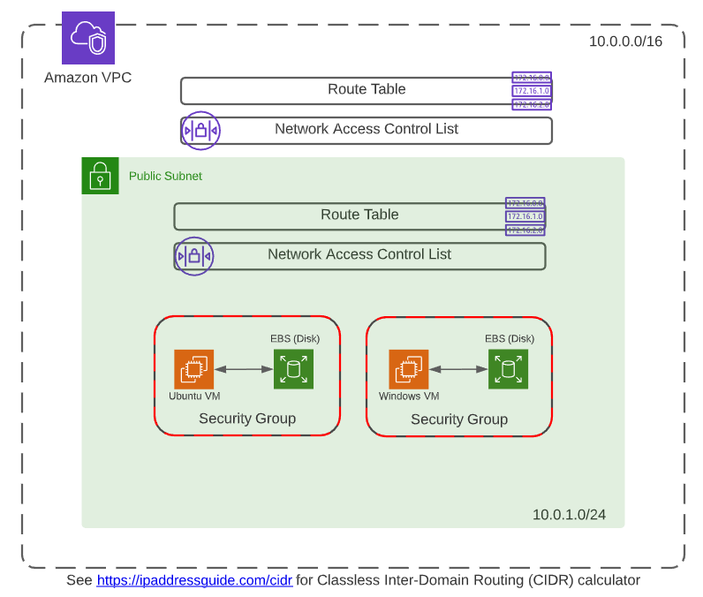
DEMO:
IaaS
Notes:
Use https://github.com/KernelGamut32/capital_group_edge_la/tree/main/demos/week03 for demo instructions (and source, if applicable)

Slide 44

Platform-as-a-Service (PaaS)
Involves leveraging managed services from a public Cloud provider
With this model, an enterprise can focus on management of their application and data vs. focusing on management of the underlying infrastructure
Patching and security of the infrastructure used to back the managed services falls to the CSP (Cloud Service Provider)

Slide 45
Platform-as-a-Service (PaaS)
Many managed services support automatic scale up or down depending on demand to help ensure sufficient capacity is in place
Can be considered synonymous with the term “Cloud native”

Slide 46
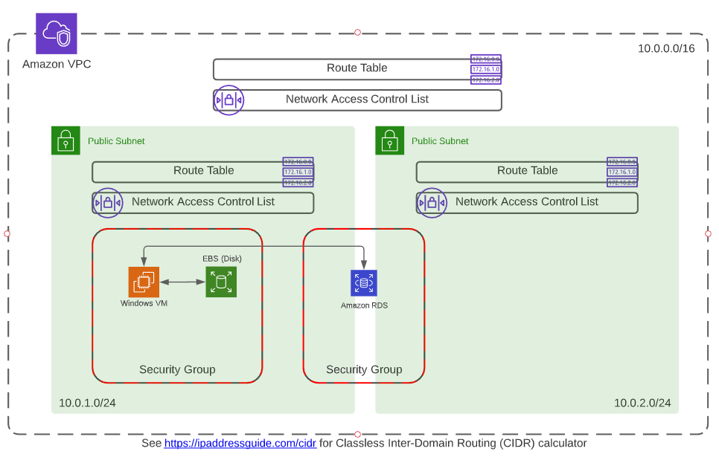
DEMO:
PaaS
Notes:
Use https://github.com/KernelGamut32/capital_group_edge_la/tree/main/demos/week03 for demo instructions (and source, if applicable)

Slide 47

Serverless / Functions-as-a-Service (FaaS)
Also represents a type of managed service provided by the CSP
Cost structure is usually consumption-based (i.e., you only pay for what you use)
Supports many different coding paradigms (C#/.NET, NodeJS, Python, etc.)

Slide 48
Serverless / Functions-as-a-Service (FaaS)
Typically, with Serverless (and PaaS), the consumer is only concerned with the application code and data – elements of the CSP’s “backbone” used to support are managed by the CSP
Includes more sophisticated automated scaling capabilities – built for Internet scale

Slide 49
DEMO:
FaaS
Notes:
Use https://github.com/KernelGamut32/capital_group_edge_la/tree/main/demos/week03 for demo instructions (and source, if applicable)

Slide 50

Software-as-a-Service (SaaS)
Subscription-based application services
Licensed for utilization over the Internet / online rather than for download and install on a server or client machine
Fully-hosted and fully-managed by a 3rd party

Slide 51
Software-as-a-Service (SaaS)
Of those discussed, often the cheapest option for service consumers
However, also offers minimal (or no) control, outside of exposed configuration capabilities

Slide 52
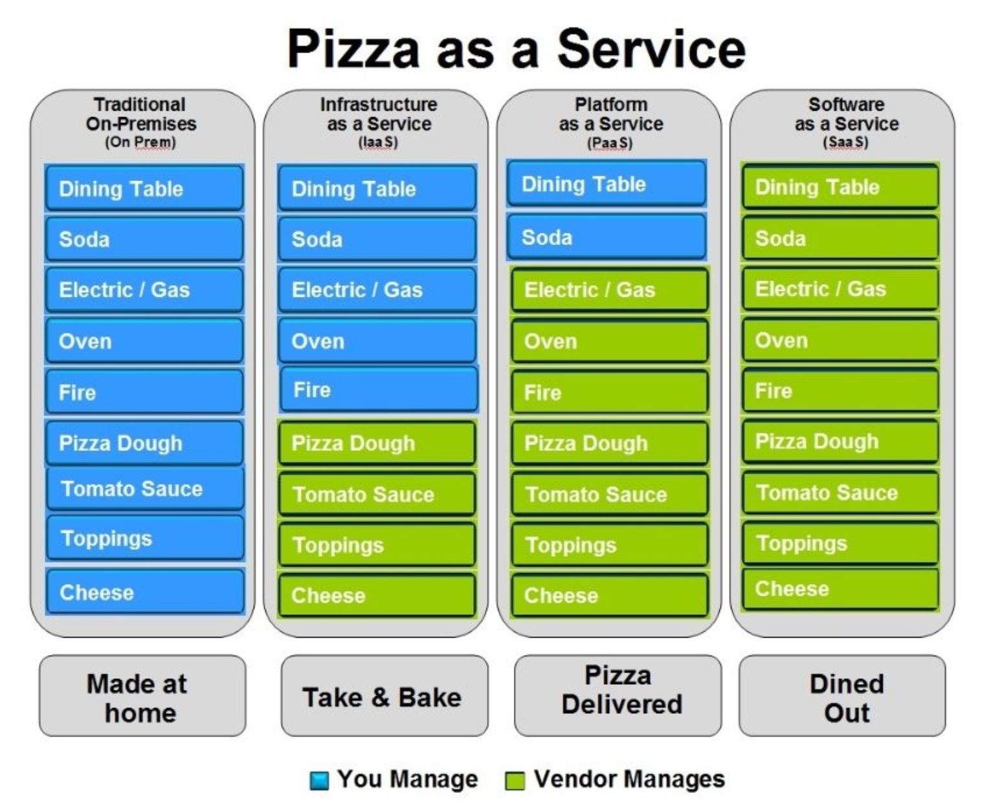
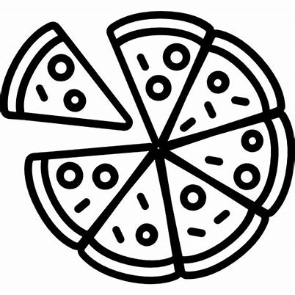
Pizza-as-a-Service
From a LinkedIn post by Albert Barron from IBM (https://www.linkedin.com/pulse/20140730172610-9679881-pizza-as-a-service/)

Slide 53
Side-by-Side Comparison
On-Prem
IaaS
PaaS / Serverless
SaaS
Servers
Servers
Servers
Servers
Storage
Storage
Storage
Storage
Customer
Networking
Networking
Networking
Networking
CSP
Virtualization
Virtualization
Virtualization
Virtualization
Control
Physical Security
Physical Security
Physical Security
Physical Security
OS
OS
OS
OS
Middleware
Middleware
Middleware
Middleware
Runtime
Runtime
Runtime
Runtime
Application
Application
Application
Application
Data
Data
Data
Data
Transfer of Responsibility

Slide 54

Containerization in the Cloud
One option includes standing up VM’s (IaaS) and installing / managing a Kubernetes cluster on those machines or
Another option includes leveraging a managed service (PaaS) provided by the CSP
Options in AWS include Elastic Container Service (ECS), Elastic Container Registry (ECR), and EKS (Elastic Kubernetes Service)
Notes:
This is largely a review slide from week 02

Slide 55
DEMO:
Containers
Notes:
Different containers-based demo
Use https://github.com/KernelGamut32/capital_group_edge_la/tree/main/demos/week03 for demo instructions (and source, if applicable)

Slide 56

Which One is Better?
The answer is “it depends”
It depends on the type of application
It depends on the enterprise

Slide 57

Which One is Better?
It depends on the skillset and expertise within the organization
It depends on whether you have budget and opportunity to modernize an application environment (in some cases)
The best option might be a combination of multiple approaches – right tool for the right job

Slide 58
LAB:
Scenario: Your company (a global leader in FinTech) is currently hosting all infrastructure used to power the business in an on-premise Data Center. This includes a mainframe for primary business functions (customer management, account management, accounts payable, accounts receivable), several Web Apps (for customer interaction), several Web APIs providing backend data and functionality to the UIs, and a system used to manage data feeds from several security cameras used at corporate offices for observation and security.
As a member of the technical staff, you have been asked to provide thoughts and recommendations on moving from the Data Center to the Cloud.
In your assigned breakout room, discuss as a group and be prepared to provide the following: 1) Recommendations for the types of hosting that could be used for the various application components, and 2) the reasoning behind your recommendations – i.e., what are some benefits you would expect the company to receive by implementing your recommendations.
Nominate someone (or volunteer) to share your group’s ideas.
Application Hosting

Slide 59
Knowledge Check
With this application hosting option, you primarily only pay for what you actually consume:
IaaS
PaaS
Serverless/FaaS
SaaS
Notes:
Type answers in chat or come off mute.
Answer is C

Slide 60
Knowledge Check
This application hosting option is used to license certain “commodity” functionality like email, CRM, etc. over the Internet:
IaaS
PaaS
Serverless/FaaS
SaaS
Notes:
Type answers in chat or come off mute.
Answer is D

Slide 61
Knowledge Check
Of the application hosting options outlined below, which of them provides the combination of greater control but less transfer of responsibility:
IaaS
PaaS
Serverless/FaaS
SaaS
Notes:
Type answers in chat or come off mute.
Answer is A

Slide 62
Cloud Native Options in AWS

Slide 63
Cloud Native Services
Readily Available
Benefits
The offers much in the way of capability and services
Relatively Easy to Configure
Cloud Scale
Notes:
Readily available on all major Cloud platforms (AWS, Azure, GCP)
Relatively easy to configure (though not necessarily easy to integrate)
Can take advantage of Cloud scale – only paying for what we need when we need it

Slide 64
Cloud Native Services
Sophisticated services that bring business value
Enable expansion of the services ecosystem of your enterprise into new areas of differentiation and segmentation
Key thing to remember – just because a service is available does not mean that you must use it (or even should use it)
There should be an architectural vision in place for leverage of the Cloud that is directly aligned with business value

Slide 65

Cloud Native Services
Why? Because Cloud services will have associated
The must be accounted for and justified as operating expense against business drivers
With good alignment and a good plan, sophisticated Cloud services can help accelerate business mission

Slide 66




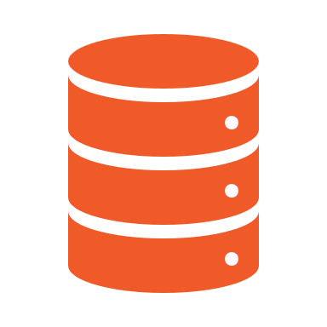
Developing for Cloud
Compute
Storage
Networking
Database

Slide 67



Compute in AWS
Includes
EC2
AWS Lambda
Elastic Beanstalk
Notes:
These slides should be coupled with a review in either the AWS management console or Azure portal – “live” demo / walkthrough

Slide 68
LAB:
Execute the tutorial available at
https://www.edureka.co/blog/ec2-aws-tutorial-elastic-compute-cloud/
EC2

Slide 69
LAB:
Execute the tutorial available at https://docs.aws.amazon.com/lambda/latest/dg/services-apigateway-tutorial.html
AWS Lambda

Slide 70



Storage in AWS
Includes
Simple Storage Service (S3)
Elastic Block Store (EBS)
AWS Snowball
Notes:
These slides should be coupled with a review in either the AWS management console or Azure portal – “live” demo / walkthrough

Slide 71
LAB:
Execute the tutorial available at https://docs.aws.amazon.com/AmazonS3/latest/userguide/HostingWebsiteOnS3Setup.html
AWS S3

Slide 72


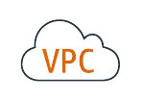
Networking in AWS
Includes
Virtual Private Cloud (VPC)/Subnets
API Gateway
Route 53
Notes:
These slides should be coupled with a review in either the AWS management console or Azure portal – “live” demo / walkthrough

Slide 73

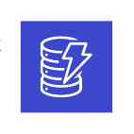
Database in AWS
Includes
Relational Database Service (RDS)
DynamoDB
Aurora
Notes:
These slides should be coupled with a review in either the AWS management console or Azure portal – “live” demo / walkthrough

Slide 74
LAB:
Execute the tutorial available at https://docs.aws.amazon.com/AmazonRDS/latest/UserGuide/TUT_WebAppWithRDS.html
Amazon RDS

Slide 75
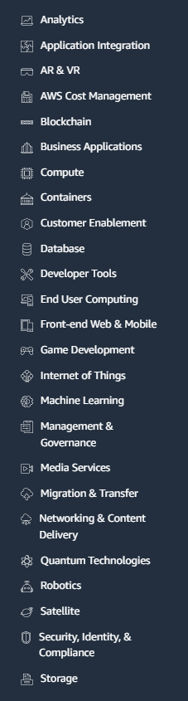

Other in AWS
Notes:
These slides should be coupled with a review in either the AWS management console or Azure portal – “live” demo / walkthrough. Drill down into a few of the interesting ones.

Slide 76



Developing on Cloud
CloudFormation
Cloud9
AWS Control Tower

Slide 77
LAB:
Execute the tutorial available at https://www.beabetterdev.com/2020/12/06/aws-cloudformation-tutorial/
AWS CloudFormation

Slide 78
Knowledge Check
When creating a Lambda function, you use this AWS service to enable execution via an HTTP REST call:
S3
RDS
EC2
API Gateway
Notes:
Type answers in chat or come off mute.
Answer is D

Slide 79
Knowledge Check
This Amazon service is used to create disk storage for our EC2 instances:
EBS (Elastic Block Storage)
Route53
EC2
DynamoDB
Notes:
Type answers in chat or come off mute.
Answer is A

Slide 80
Data Management Lifecycle

Slide 81
Data Management – Stages
Ingestion
Scrubbing & Normalization
Aggregation
Analysis & Intelligence Gathering
Notes:
Relate these slides to Cloud technologies and Cloud enablement

Slide 82
Data Ingestion
Could be via message exchange or streaming
Depending on size/scope, may translate to LARGE amounts of incoming data
Ingestion
Scrubbing & Normalization
Aggregation
Analysis & Intelligence Gathering

Slide 83
Data Ingestion
Because of potential scale, bandwidth may be a concern
Depending on application, latency may also be a concern
Data may require translation (e.g., from low-level bytes to object or JSON)
Ingestion
Scrubbing & Normalization
Aggregation
Analysis & Intelligence Gathering
Notes:
Medical info, autonomous vehicles, streaming data may be less tolerant of latency issues

Slide 84
Data Ingestion
Event hubs or streaming analytics platforms support ingestion at scale
Provide time and context-aware processing for correct sequencing
Data may flow through intermediate storage on way to final processing
Depending on sensitivity of data, could require robust security at each stop
Ingestion
Scrubbing & Normalization
Aggregation
Analysis & Intelligence Gathering

Slide 85
Data Ingestion – What About the Edge?
Edge components (e.g., gateways) can help optimize
Preliminary processing at the edge can be used to filter what really matters
Potential for bundling or compressing data for transmit to cloud
Can help with bandwidth or latency issues
Ingestion
Scrubbing & Normalization
Aggregation
Analysis & Intelligence Gathering
Notes:
For example, streaming applications – multiple, related pieces of the stream can be gathered at the Edge and processed as a complete unit

Slide 86
Data Scrubbing & Normalization
Depending on payload, some portions of the data may not be needed
Or some portions might contain sensitive detail
Those parts not needed or sensitive can be “scrubbed” to exclude
Ingestion
Scrubbing & Normalization
Aggregation
Analysis & Intelligence Gathering

Slide 87
Data Scrubbing & Normalization
Represents another potential optimization that can preserve storage
In other cases, similar data may be coming in multiple, disparate formats
Ingestion
Scrubbing & Normalization
Aggregation
Analysis & Intelligence Gathering

Slide 88
Data Scrubbing & Normalization
Normalization can bring consistency to the disparate content
By normalizing, becomes a single dataset for comprehensive analysis
Normalization may happen as part of ingestion or as part of a separate step
Ingestion
Scrubbing & Normalization
Aggregation
Analysis & Intelligence Gathering
Notes:
Temperature/humidity is temp/humidity – regardless of the device and how the device communicates it

Slide 89
Data Scrubbing & Normalization – What About the Edge?
Depending on complexity, may execute faster closer to the data
Might involve proprietary algorithms best kept within full control
Allows addressing of sensitive data before routed to Cloud
Can also provide additional optimization (relative to bandwidth)
Ingestion
Scrubbing & Normalization
Aggregation
Analysis & Intelligence Gathering

Slide 90
Data Aggregation
Helps provide full picture of data from multiple streams
May also be used to enrich with info from other data sources
Data will be stored in persistent storage for downstream analysis & reporting
Ingestion
Scrubbing & Normalization
Aggregation
Analysis & Intelligence Gathering

Slide 91
Data Aggregation
In statistical analysis, the larger the sample size, the more accurate the inference
To manage costs, large sets of data may leverage different types of storage:
Hot storage – most recent data and most relevant for current analysis
Cool storage – data not actively used but potentially relevant (short-term trends)
Cold or archive storage – data kept for historical purposes and long-term trending
Security of the stored data and encryption at rest become critical
Ingestion
Scrubbing & Normalization
Aggregation
Analysis & Intelligence Gathering

Slide 92
Data Aggregation – What About the Edge?
Provides an additional layer of storage
Data not transmitted to Cloud (due to optimizations) may still be valuable to keep
Enables storage of sensitive data in “raw” format in controlled environment
Can help balance costs against short to mid-term retention requirements
Ingestion
Scrubbing & Normalization
Aggregation
Analysis & Intelligence Gathering

Slide 93
Data Analysis & Intelligence Gathering
In the digital age, data is the competitive edge
Companies that manage their data as a critical asset succeed
Keys:
Aggregating efficiently
Analyzing effectively
Ingestion
Scrubbing & Normalization
Aggregation
Analysis & Intelligence Gathering

Slide 94
Data Analysis & Intelligence Gathering
Goal is to identify and leverage the most important data points
Importance is measured by business value-driven decision-making
What can I learn about today’s customers, scenarios, or business cases?
What can I effectively predict about tomorrow?
Ingestion
Scrubbing & Normalization
Aggregation
Analysis & Intelligence Gathering

Slide 95
Data Analysis & Intelligence Gathering
Requires balancing of competing concerns:
To increase quality of intelligence, more data is required (sometimes MUCH more)
But massive datasets can be complex to manage and process
Ingestion
Scrubbing & Normalization
Aggregation
Analysis & Intelligence Gathering

Slide 96
Data Analysis & Intelligence Gathering
Enter ML / AI:
Algorithms are used to build mathematical models from existing data
Results in a mathematical “trajectory” (and confidence level)
Algorithms can be configured to learn and improve over time
Hyperscale available in the Cloud brings near-limitless power to bear
Ingestion
Scrubbing & Normalization
Aggregation
Analysis & Intelligence Gathering

Slide 97




Overview - What is AI?
Artificial intelligence (AI) applies advanced analysis and logic-based techniques, including machine learning, to interpret events, support and automate decisions and take action
It is the quest to build machines that can reason, learn, and act intelligently, and it has barely begun
MIT
Gartner
AI is computer programming that learns and adapts. It can’t solve every problem, but its potential to improve our lives is profound
It is the capability of a computer system to mimic human-like cognitive functions such as learning and problem-solving
Google
Microsoft

Slide 98
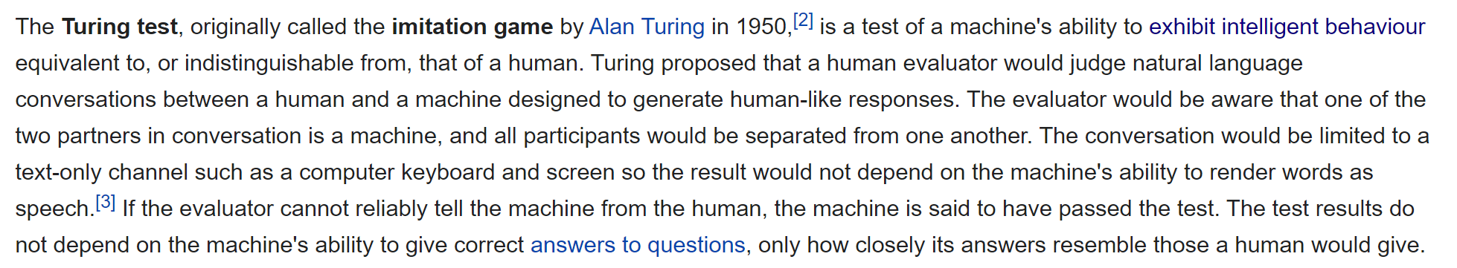
The Turing Test
https://en.wikipedia.org/wiki/Turing_test

Slide 99
Machine Learning Examples
See https://www.businessinsider.com/shane-wighton-robotic-basketball-hoop-cant-miss-2020-5
See https://breakingdefense.com/2020/08/ai-slays-top-f-16-pilot-in-darpa-dogfight-simulation/
See https://www.schwab.com/automated-investing/what-is-a-robo-advisor
Notes:
Capital Group – mission is people-driven investing (robo-investing not on the Northstar) based on research and using technology

Slide 100
LAB:
Responsible AI is a discipline that seeks to ensure we are developing and using Machine Learning/AI in a manner that eliminates unfair bias and that strikes the proper balance between efficiency and benefits to humankind.
Pick one of the examples from the previous slide. In your assigned breakout room, discuss as a group and be prepared to provide the following: 1) what are some benefits that you could see for the greater good from the given application of intelligence in technology, and 2) what are some potential ways that the technology could be abused for less noble purposes.
Nominate someone (or volunteer) to share your group’s ideas.
Responsible AI
Notes:
Responsible AI – link to some of the internal documents at Capital Group (follow on review materials)

Slide 101
Types of Machine Learning
Machine Learning
Supervised
How it works?
Step 1. Label input data that defines output variables.
Step 2. Train the algorithm on the data to find the connection between input variables and output.
Step 3. Once training is completed, then apply the algorithm to new data.
What is Supervised Learning?
An algorithm uses training data and feedback from human users to learn the relationship between given inputs and a given output

Slide 102
Types of Machine Learning
Machine Learning
Supervised
Unsupervised
How it works?
What is Unsupervised Learning?
Step 1. Algorithm receives unlabeled data.
Step 2. It infers the schema from the data.
Step 3. The algorithm identifies groups of data that exhibit similar behavior.
It is more exploratory in nature. An algorithm explores relationships in input data without being provided an explicit output variable.

Slide 103
Types of Machine Learning
Machine Learning
Supervised
Unsupervised
Reinforcement
What is Reinforcement Learning?
How it Works?
An algorithm learns to perform task simply by trying to maximize the rewards it would receive for its actions.
Step 1. Algorithm takes an action affecting the environment.
Step 2. It receives a reward if the action brings the machine a step closer to max. available reward.
Step 3. The algorithm optimizes for the best series of actions by correcting itself over time.
Algorithms
REWARD
STATE
ACTION
Environment

Slide 104
Types of Machine Learning
Machine Learning
Supervised
Unsupervised
Reinforcement
Regression
Clustering
Self Driving Cars
Classification
Recommender Systems
Playing Games

Slide 105

DEMO
Analyze Image
Notes:
Execute https://app.pluralsight.com/labs/detail/d62b4745-b08d-4989-9b5e-5907d9a28561/toc on AWS

Slide 106
DEMO
Assessing Sentiment
Notes:
Execute https://aws.amazon.com/getting-started/hands-on/sentiment-analysis-amazon-aurora-ml-integration/ on AWS

Slide 107
LAB:
Scenario: Your company (a global leader in FinTech) is currently hosting all infrastructure used to power the business in an on-premise Data Center. This includes a mainframe for primary business functions (customer management, account management, accounts payable, accounts receivable), several Web Apps (for customer interaction), several Web APIs providing backend data and functionality to the UIs, and a system used to manage data feeds from several security cameras used at corporate offices for observation and security.
As a member of the technical staff, you have been asked to provide thoughts and recommendations on moving from the Data Center to the Cloud.
In your assigned breakout room, discuss as a group and be prepared to provide the following: 1) Thoughts on the types of data you would expect to gather in the Cloud for this system (once migrated), 2) ways that you could leverage the data management lifecycle to help you gather and manage, and 3) any intelligence/insights you might hope to get out the information once aggregated.
Nominate someone (or volunteer) to share your group’s ideas.
Data Management
Ingestion
Scrubbing & Normalization
Aggregation
Analysis & Intelligence Gathering

Slide 108
Operating in the Cloud

Slide 109

Monitoring in the Cloud
Monitoring & logging are key considerations in any Cloud environment
Systems (you hope) will be running around-the-clock – maximizing business benefit
Unless you want to directly “babysit” those systems around-the-clock, you will need automated monitoring, logging and alerting to notify you of any issues
Allows you to optimize handling for those exceptional cases when there is a problem
Notes:
Problems should be the exception, not the rule. Otherwise, you must question the design of the system.

Slide 110
Monitoring in the Cloud
Capabilities exist to log and aggregate log data from the public Cloud
There are likely already processes in place to monitor on-premise systems
The goal is a strategy that allows you to pull that data together so you can analyze and make decisions holistically
Notes:
A company’s data and the intelligence it can derive from that data toward identifying and enabling business innovation is the competitive differentiator

Slide 111
Endpoint Protection & Security
The services exposed by a company used to provide its business value are critical
The data consumed by a company in the provision of that business value could be very sensitive
There are multiple regulations in place requiring the protection of sensitive data (e.g., PCI, SOX, HIPAA and GDPR)
Failure to adhere to those regulations can cost a company significantly – either in actual $’s or in reputation (which can be more damaging)
Notes:
GDPR = General Data Protection Regulation
Think about all of the news stories you come across where it has been reported that a company failed to protect its customer’s data – what is your attitude toward that company when a breach occurs?

Slide 112
Endpoint Protection & Security
The issue is not only one of data security – there are “bad actors” that work to take down sites and services
One of the ways that service can be hindered is through a DDoS (Distributed Denial of Service) attack
For DDoS, attackers will attempt to “flood” a service with so much bogus volume that it becomes unable to satisfy real business requests
Notes:
Talk about how this is sometimes discussed in terms of Layer 3 (network firewall) vs. Layer 7 (application firewall) protection

Slide 113
Endpoint Protection & Security
Most Cloud platforms provide services to help you protect against a DDoS attack
Can include API management services (subscriptions, key-based access, throttling)
Web Application Firewall (or WAF) is another service provide by Cloud platforms to monitor, filter and block (if required) incoming traffic
Notes:
Talk about how this is sometimes discussed in terms of Layer 3 (network firewall) vs. Layer 7 (application firewall) protection
– e.g., if your company provides an API, subscriptions via API key and throttling can be used to help manage
Will discuss further during topic on Cybersecurity

Slide 114
Endpoint Protection & Security
Potential Challenges
The threat and regulatory landscapes are constantly evolving
In a Hybrid Cloud scenario, creating a solution that gives you comprehensive protection across your on-premise resources, your Cloud resources and the connectivity between the two is not trivial
Optimal application security and infrastructure security requires planning and specialized skillsets
Good architectural practices (e.g., Least Privilege and Secure-by-Default) can help limit the “blast radius”
Notes:
Use as an opportunity for discussion – ask students for ideas on challenges
Talk about potential solutions (conceptually) to the challenges

Slide 115
DEMO
Operational Management in the Cloud
Notes:
Use https://docs.aws.amazon.com/AmazonCloudWatch/latest/monitoring/CloudWatch-tutorials.html (for AWS)

Slide 116
Cloud Modernization

Slide 117

Application Portfolio Assessment
Will likely include
Review of the current state architecture
Discussion with stakeholders about roadmap and plans for target state
Discussion on expected timing
The goal is to ensure that migration efforts are focused on the activities that will bring greatest business benefit against optimized cost
Notes:
(e.g., not wasting time planning migration for an application that is targeted for retirement by the organization)
Talk about recent effort with large, national insurance provider – walk through process flow utilized to plan and assess

Slide 118
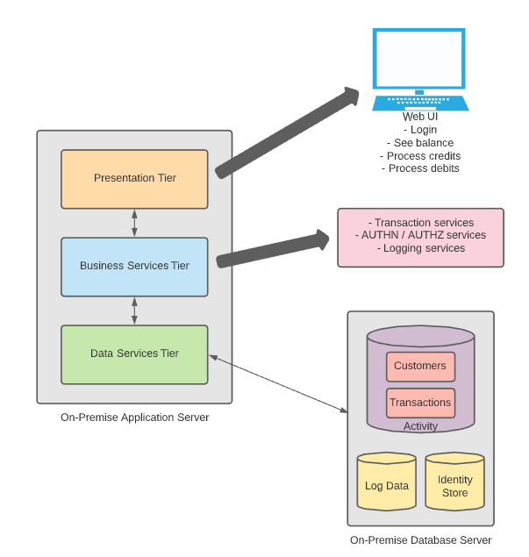
Banking App – Current State
Notes:
Assume you’re assisting a client that is considering modernizing an on-premise banking application to the Cloud. Currently, the banking application consists of a set of modules integrated together into one large web application that runs as a single process on servers in the data center. It interfaces with tables in a database to store and utilize customer information and transaction information (debits/credits). Because of the size and complexity of the application, the company only deploys updates 3 times a year - to be considered for the update window, a development team must have all changes unit and integration tested by a freeze date.
Do you notice any potential issues with this design or application management strategy? Use as a way to drive a discussion with students about opportunities for moving from current state to a Cloud native approach.

Slide 119
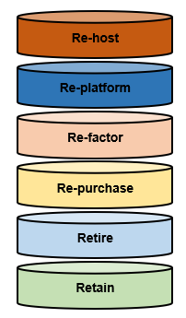
The 6 R’s – Application Migration Strategies

Slide 120
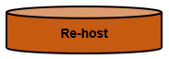
AKA “lift & shift”
For all intents and purposes, involves recreating the on-premise infrastructure in the Cloud
Sometimes used to expedite retirement of a data center

Slide 121
Can be a mechanism to quickly migrate workloads and see immediate cost savings, even without Cloud optimizations
There are third-party tools available to help automate the migration
Once the application is in the Cloud, it can be easier to apply Cloud optimizations vs. trying to migrate and optimize at the same time

Slide 122
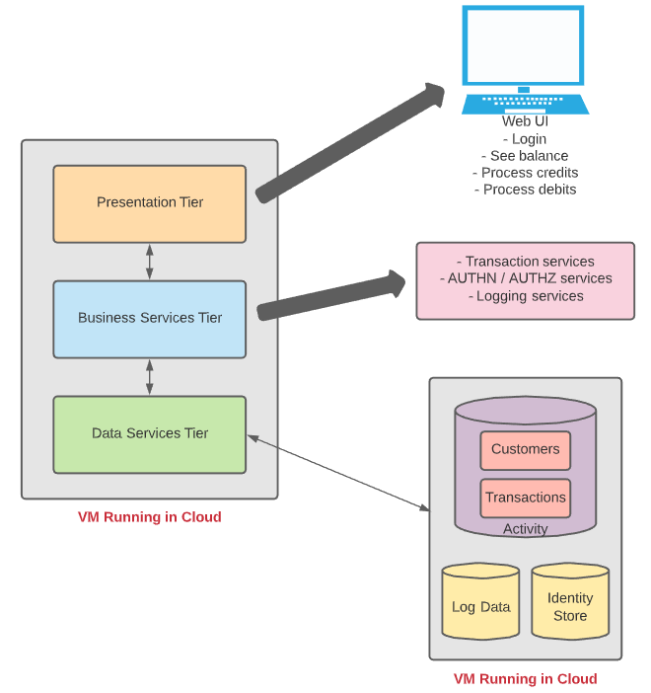

Slide 123
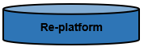
AKA “lift, tinker & shift” or “lift & fiddle”
Core architecture of the application will not change
Involves recreating most of the on-premise infrastructure in the Cloud with a few Cloud optimizations

Slide 124
Those optimizations will involve a move to one or more Cloud native services for a specific, tangible business benefit
A common example is moving to a managed database (e.g. Relational Database Service, or RDS, in AWS)
Enables migration speed while providing cost savings or benefit in a targeted portion of the application’s architecture

Slide 125
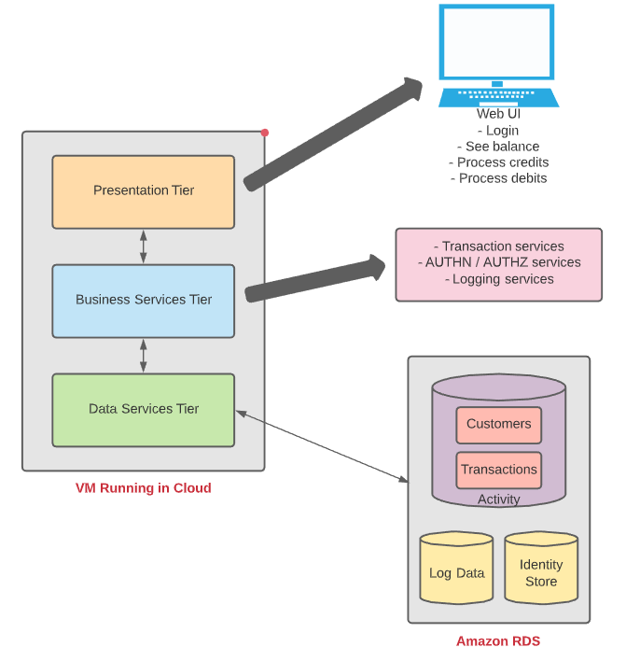

Slide 126
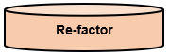
Involves rearchitecting the application to maximize utilization of Cloud native optimizations
Likely the most expensive and most complex of the available options
The application profile needs to fit, and business value must be identified commensurate with the cost required to execute

Slide 127
Good option if the application can benefit from features, scalability or performance offered by the Cloud
Examples include rearchitecting a monolith to microservices running in the Cloud or moving an application to serverless technologies for scale

Slide 128
?
To Be Determined

Slide 129
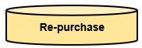
Good fit for applications that are candidates for moving from on-premise licensing (for installed products) to a SaaS model
Often applications that have been installed to manage a specific type of business capability
Examples can include Customer Relationship Management (CRM), Enterprise Resource Planning (ERP), HR or e-mail (among others)

Slide 130
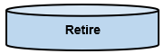
In some cases, an enterprise may have a “healthy” percentage of legacy applications that are no longer being used or maintained (especially for larger organizations)
When completing the Application Portfolio Assessment and associated interviews with application owners, look for opportunities to recommend retire of the unused legacy apps
This type of application can represent a “quick win”

Slide 131
The associated savings can potentially be advantageously factored into the business case for the Cloud modernization effort
Finally, retiring unused apps reduces attack surface area from a security perspective

Slide 132
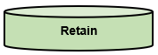
Applications that must remain in place but that cannot be migrated to the Cloud without major refactor
This type of application profile may prevent the ability to completely move out of the data center (at least in the interim)
From a cost perspective, it can be difficult for an enterprise to take on both the operating expense of Cloud while continuing to carry the capital expense of a data center and on-premise infrastructure
The hybrid model can be a good solution to support where needed
Notes:
(e.g. on-premise mainframe)

Slide 133
LAB:
Scenario: Your company (a global leader in FinTech) is currently hosting all infrastructure used to power the business in an on-premise Data Center. This includes a mainframe for primary business functions (customer management, account management, accounts payable, accounts receivable), several Web Apps (for customer interaction), several Web APIs providing backend data and functionality to the UIs, and a system used to manage data feeds from several security cameras used at corporate offices for observation and security.
As a member of the technical staff, you have been asked to provide thoughts and recommendations on moving from the Data Center to the Cloud.
In your assigned breakout room, discuss as a group and be prepared to provide the following: 1) Thoughts & recommendations on which of the 6 R’s you’d recommend for each of the high-level infrastructure components used at the company, and 2) any business or technical drivers behind your recommendations.
Nominate someone (or volunteer) to share your group’s ideas.
Application Hosting

Slide 134
Banking App
If you wanted to sell an investment project to a client for rearchitecting this application for migration to the Cloud, what are some of the potential benefits you might put forth as justification?
Notes:
What does the business get for the investment? Student discussion.

Slide 135
CI/CD in AWS

Slide 136
What a difference 45 minutes can make!!

Slide 137


How Long Does it Take for a Company to Go Bankrupt?
If the circumstances are right, it can happen in just 45 minutes!
Notes:
We’re going to talk about an (albeit extreme) example of what can go wrong in the deployment of new software and how lack of DevSecOps practices at one company (Knight Capital Group) resulted in a $460M loss in just 45 minutes.

Slide 138











Knight Capital Group – What Happened?
Automated Stock
Trading System
Receives Large
Trading Orders
(“Parents”)
Automates Breakup
into Smaller
“Child” Orders
Manual
Deployment to
Eight Servers
New Functionality
Thoroughly Tested
Repurposed Old
Code to Implement
Trading Starts
(9:30 a.m.)
One Server Missed
(Human Error)
Serious Problem
Experienced Live
10:15 a.m.
Tried Frantically
to Fix
Missed Server Not
Bounding “Child” Orders
Against “Parent” Size
$460M loss vs. $365M in assets!
Source: https://dougseven.com/2014/04/17/knightmare-a-devops-cautionary-tale/
Notes:
Talk through the details of the specific scenario
For tried frantically to fix – no good observability/messaging for troubleshooting; assuming issue with new code, rolled back all new code which left the 7 “good” servers with the same problem as the 1 “bad” one.

Slide 139

Moment of Reflection
From the brief overview of the Knight Capital Group scenario, can you identify any specific implementation choices that might’ve led to the issues encountered?
Type your answer in chat or come off mute and share

Slide 140
DevOps – What it is & why it’s valuable
Notes:
Quick review of some of the concepts already discussed in the context of the KCG scenario

Slide 141


Approach Used In the “Olden” Times
#$@&%*!!!
Development
Operations
#$@&%*!!!
Development & Operations siloes
Lack of understanding of the other perspective
Lack of communication & partnership
“Fire and forget” engagement

Slide 142


DevOps – The New Way
Development
Operations
Development & Operations work together
Each understands & appreciates the position of the other
Good communication, partnership, & collaboration
Ongoing engagement – continuous improvement

Slide 143
DevOps – The Three Ways
The First Way: Flow/Systems Thinking
Business
Customer
Source: Gene Kim (https://itrevolution.com/the-three-ways-principles-underpinning-devops/)
Development
Operations
Holistic vs. siloed view – success is defined by the performance of the entire system vs. a specific team or individual
Starts with requirements (defined by the business) and not called “done” until value is delivered to the customer
Target outcomes:
Known defect never passed to downstream teams
Favor global performance vs. focusing on local optimization
Goal is increased flow (value)
Asking ourselves the question: “What don’t I know about our systems?”

Slide 144
DevOps – The Three Ways
The Second Way: Amplify Feedback Loops
Source: Gene Kim (https://itrevolution.com/the-three-ways-principles-underpinning-devops/)
Development
Operations
Create right-to-left feedback loops
Shorten & amplify so information needed to make continuous improvements & continuous correction is readily available
Target outcomes:
Understanding all customer perspectives (internal & external)
Responding to all customer concerns (internal & external)
Knowledge is power!

Slide 145

DevOps – The Three Ways
The Third Way: Culture of Continual Experimentation & Learning
Source: Gene Kim (https://itrevolution.com/the-three-ways-principles-underpinning-devops/)
Development
Operations
Culture that fosters:
Continual experimentation, risk-taking, and learning from failure
Practice makes perfect!
Target outcomes:
Allocating time for continual improvement (e.g., resolution of technical debt as a standard “category” of work)
Taking risks and seeing them pay off – No guts no glory!
Expecting failure & building resiliency into the process
Notes:
Risk aren’t bad – reckless risks are

Slide 146
Continuous Delivery

Slide 147
Continuous Delivery
Continuous Integration
Continuous Testing
Continuous Deployment
Continuous Value
Continuous Delivery

Slide 148
Continuous Integration

Slide 149
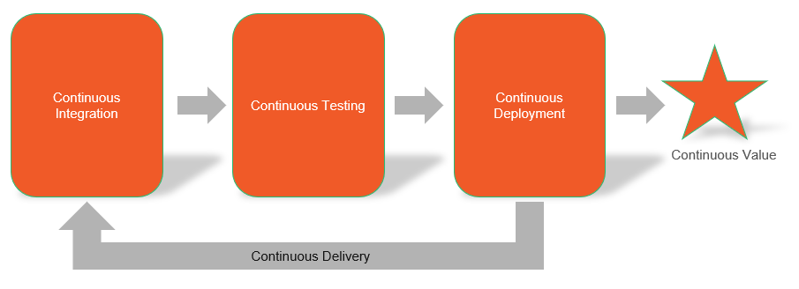
Continuous Integration
Changes from individual developers are merged & system is validated “as a whole”
Code changes are detected & automated processes are executed to assess
Any issues uncovered are communicated to the developers for remediation (feedback)
Targeted testing (i.e., unit testing) executed as part of CI flow

Slide 150
Continuous Integration
Initiation is often event-driven
Rather than waiting for a “critical mass” of changes before starting our testing, each change can be exercised & validated as it gets persisted to the centralized code repository
Amplifies the feedback loop rather than burying in a “sea” of other changes
Sets the stage for multiple types of validation (including security validation, or DevSecOps)

Slide 151
Continuous Integration
Best practices:
Minimize dependencies between features – each feature should be able to stand on its own
Work to drive out manual steps and make automation the priority
Stabilize data sources & other system dependencies through mocking
Include assessment of code quality (e.g., cyclomatic complexity) & unit test coverage as key parts of verification workflow

Slide 152
Continuous Testing

Slide 153
Continuous Testing
Common Types | Description
Unit testing | Testing discrete units of code in isolation from other code (e.g., testing a single method). Leverages mocking to stabilize other system dependencies so that tests are repeatable. Code coverage often used to assess quality & sufficiency of unit testing. Should be automated.
Regression testing | Testing that verifies that newly introduced changes for development of a feature do not inadvertently break other, existing features. Automated unit tests can also fill the role of a regression test suite nicely. Quickly confirming no breakages.
Integration testing | Testing that verifies that groups of components & component features operate correctly when combined with other features (e.g., multiple functions or modules that provide a larger “chunk” of functionality). Usually represents a layer above unit testing but below functional testing. Should be automated.
Functional testing | Testing that verifies functional requirements for critical workflows in the software end-to-end. Can be (and probably should be) implemented as automated black box tests, requiring minimal knowledge & minimal assumptions about the inner workings of the software.
Acceptance testing | Testing that verifies the functionality of the software against specific acceptance criteria defining the difference between “good” & “bad”. May include manual testing/utilization by a subset of testers to verify that the software will operate correctly when leveraged by end users in production. AKA does the software do what it is supposed to from the end user’s perspective?
Security testing | Testing that verifies the functionality of the software against critical security requirements as identified & prioritized via threat modeling. Through a combination of static & dynamic testing, assesses the software for security vulnerabilities or deficiencies from a compliance & regulatory perspective (A.K.A. DevSecOps). Examples include SQL Injection and Cross-Site Scripting.
Performance testing | Testing that verifies that the software will meet defined SLAs (Service Level Agreements) when exercised under load or stress. Can also be used to validate the software’s ability to elastically scale (out or in) based on volumes. How does the software perform under load?
Notes:
Speak high-level to the chart – material we’ve covered before. More for reference.

Slide 154
Continuous Testing
How does Continuous Integration help promote software quality?
Maximizes the use & benefits of automation to enable “early & often”
Provides multiple “hooks” within the workflow for plugging in the various types of testing
Enables integration of testing results into the pipeline as quality gates
Accelerates test result feedback for visibility & effective disposition

Slide 155
Continuous Deployment

Slide 156
Continuous Deployment
Does not necessarily mean continuously deployed, but rather continuously ready to deploy
Through a release pipeline, seeks to push latest version of the software through the environments at the frequency required by the business
Intended to help get innovation “quickly” into the hands of users & customers for serving needs & gathering feedback

Slide 157
Continuous Deployment
Version management:
Often leverages semantic versioning (major.minor.patch)
Often leverages explicit versioning
Seeks to keep a clear distinction & separation between each version of the software
Goal is version traceability & visibility when upgrade is possible, or rollback is required
Notes:
Talk about what each aspect of semantic versioning means:
Patch – bug fixes
Minor – enhancements but expected to remain backwards compatible
Major – likely breaking change

Slide 158
Continuous Deployment
Blue/Green testing:
Maintains two (or more) identical hosting environments
Provides the opportunity to run multiple versions of the software in parallel
Production traffic is managed through routing – switch routing from old to new, & verify
If issues uncovered, routing can be switched back to previous version for quick rollback

Slide 159
Continuous Deployment
Canary testing:
Provides the opportunity to run multiple versions of the software in parallel
Small portion of traffic can be routed to new version to ease in adoption
Allows verification of new version in lower risk manner (like a canary in a coal mine)
As confidence in new version builds, more and more traffic can be transitioned over until new version is used exclusively

Slide 160
LAB:
Using the details of the Knight Capital Group incident (https://dougseven.com/2014/04/17/knightmare-a-devops-cautionary-tale/) and the information reviewed in the past few slides, in your assigned breakout room, discuss the following:
What are some of the primary issues you see with Knight Capital Group’s approach (and that you believe might have led to their “downfall”)?
Where could the principles of CI/CD and DevOps have assisted in preventing those issues?
Nominate someone (or volunteer) to share your group’s ideas.
Responsible AI

Slide 161

So, What Went Wrong?
Repurpose of legacy code and legacy flags/variables without proper quality checks
Fully manual deployment
No “kill switch” and no clear path to rollback
Insufficient observability and monitoring to alert resources to issues
Forced to test and troubleshoot live in Production
Notes:
Deployment and validation is SLOW
Quality confirmed in isolated environment but unable to validate in Production-like environment
Can’t get the information needed live to troubleshoot and fix
Can’t respond quickly enough to isolate issues
Forced to test and troubleshoot live in Production – damage is already done!!!

Slide 162
Building Blocks & Knight Capital Group
Software remains in a “ready to release” state enabling agility
Copious and effective monitoring alerts us to problems quickly so we can respond quickly
Continuous Delivery
Continuous Monitoring
Continuous Integration
Continuous Deployment
Automated Infrastructure
Automated testing finds issues quickly and helps ensure quality/reduce fear when releasing
Automated release at the “push of a button” reduces element of human error
Automated build out of secure runtime environments (and ability to quickly roll back in the event of a discovered issue) drives stability
Notes:
Continuous Integration – Sounds like KCG did a relatively decent job of testing but automation helps verify quality at scale

Slide 163
AWS CodeBuild – The What & How

Slide 164
LAB:
Execute the tutorial available at https://docs.aws.amazon.com/codebuild/latest/userguide/getting-started.html
AWS CodeBuild

Slide 165
LAB:
Execute the tutorial available at https://docs.aws.amazon.com/codebuild/latest/userguide/sample-build-badges.html
AWS CodeBuild – Build Badges

Slide 166
DEMO
Docker Custom Image in CodeBuild
Notes:
https://docs.aws.amazon.com/codebuild/latest/userguide/sample-docker-custom-image.html

Slide 167
AWS CodePipeline – The What & How

Slide 168
LAB:
Execute the “Simple Pipeline Walkthrough” tutorial available at https://docs.aws.amazon.com/codepipeline/latest/userguide/tutorials-simple-s3.html
AWS CodePipeline

Slide 169
DEMO
Create a Four-Stage Pipeline
Notes:
https://docs.aws.amazon.com/codepipeline/latest/userguide/tutorials-four-stage-pipeline.html

Slide 170
LAB:
Execute the CloudFormation/CodePipeline tutorials available at https://docs.aws.amazon.com/codepipeline/latest/userguide/tutorials-cloudformation.html
AWS CodePipeline

Slide 171




Thank you!
If you have additional questions, please reach out to me at:
(email address)

